Slide 1
Sample AE Lessons
Intended to Stimulate an Interest in STEM
Presented by
Major David W. Snyder
Civil Air Patrol

Slide 2
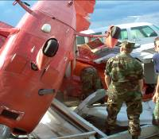

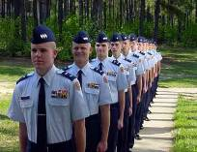

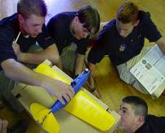

Civil Air Patrol’s Three Missions
SAR/DR
Homeland Security
Counterdrug
Humanitarian Services
Emergency Services
Leadership
Physical Fitness
Activities
CAP School Program
Cadet Programs
CAP Members
AE Members
General Public
AFROTC Flights
Aerospace Education

Slide 3
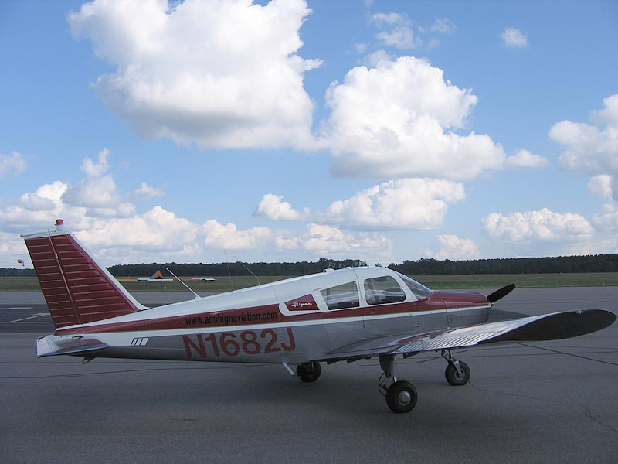
Principles of Flight
Aerodynamics & Aircraft design
Capt. Terese Barta

Slide 4
Aerospace Education
Who made airplanes fly?
  …is HISTORY
How do airplanes fly?
    …is math and science
Where do airplanes fly?
    …is geography and Social Studies

Slide 5
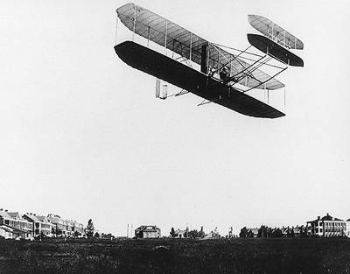
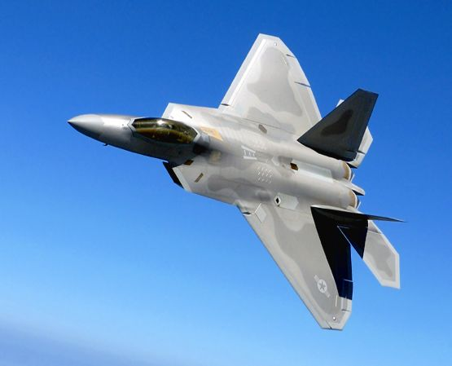
Wright Flyer, 1903
F/A-22 Raptor, 2005
Notes:
We’ve come a long way in about 100 years!

Slide 6
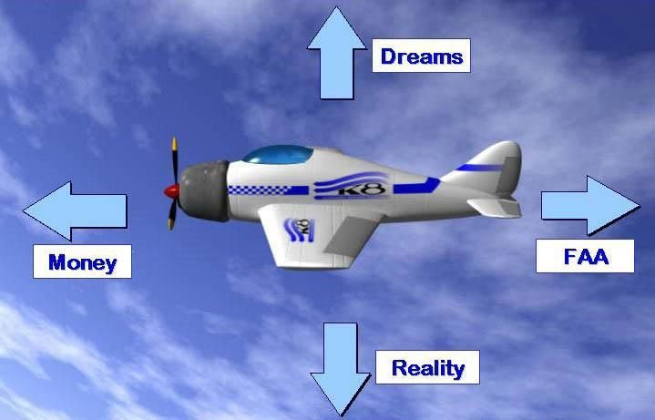
Lift
Thrust
Drag
Weight
What creates LIFT????
Notes:
The 4 balanced in straight and level un-accelerated flight

Slide 7
What creates LIFT?

Slide 8
LIFT determined by:
Shape
Speed
Angle of Attack
Notes:
The airfoil is a big part of it—creates the pressure difference
Going faster, creates a bigger pressure difference on the wing
Changing AoA also increases lift by changing pressure (up to a point)

Slide 9
Shape:
Airfoils create a difference in pressure

Slide 10
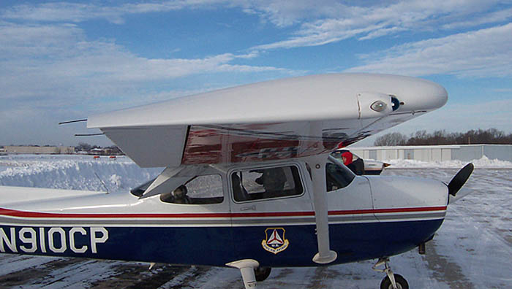
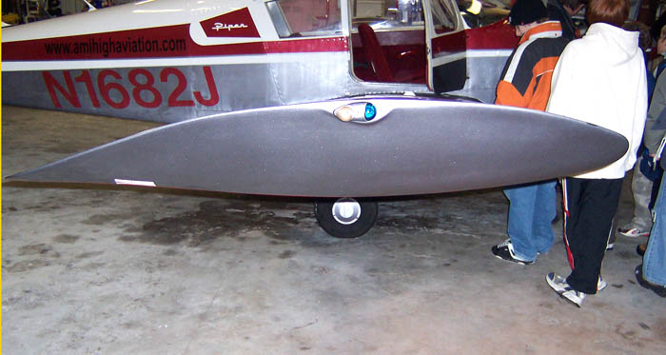
Airplane wings are AIRFOILS

Slide 11
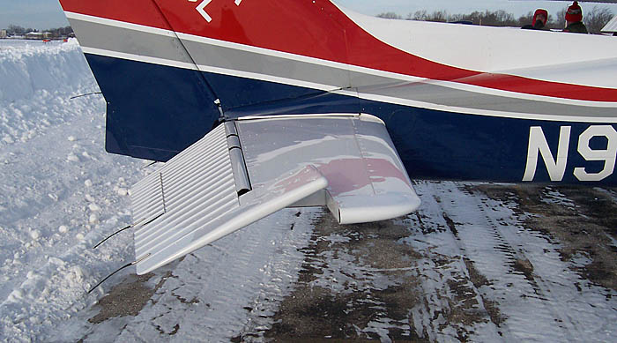
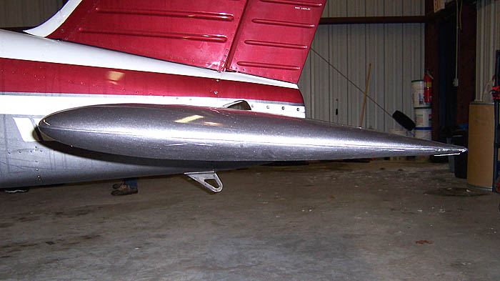
The tail also is a “wing,” (airfoil)
which is used to direct the pitch of the plane

Slide 12
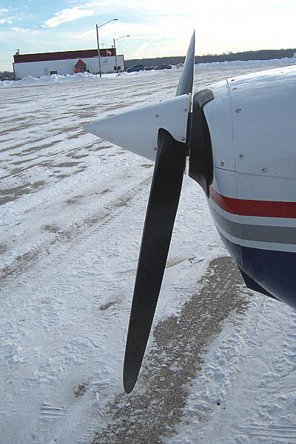
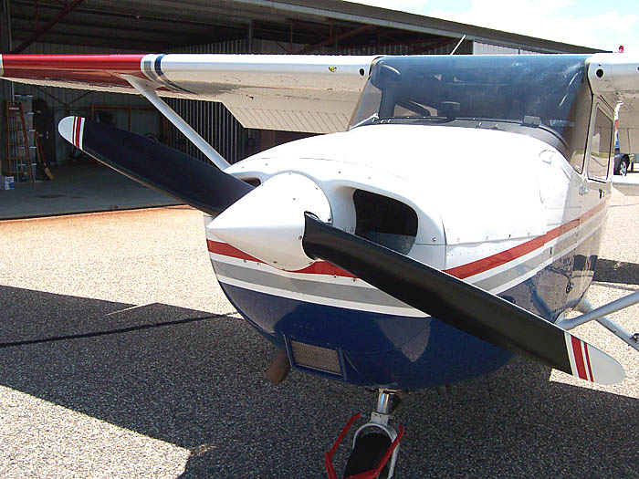
The propeller is also a type of airfoil—it produces the needed THRUST
Notes:
Thrust
Thrust: forward force; involved in creating lift b/c gets air mvg ovr wing

Slide 13
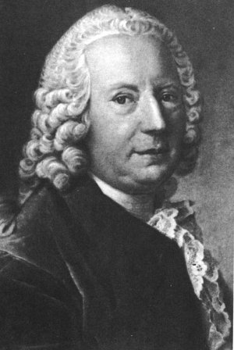
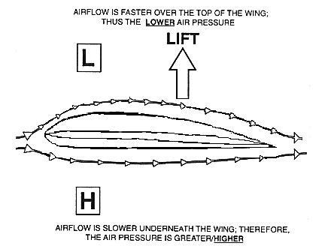
Traditional theories invoke the Bernoulli equation:
Static pressure + dynamic pressure = constant
Bernoulli's Principle states that as the speed of a moving fluid increases, the pressure within the fluid decrease
Daniel Bernoulli
(1700-1782)
Notes:
Demonstration of Bernoulli’s principle at:
http://home.earthlink.net/~mmc1919/venturi.html

Slide 14
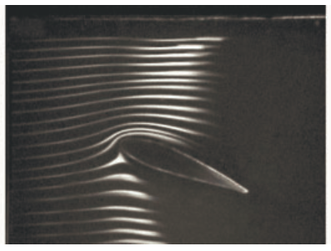
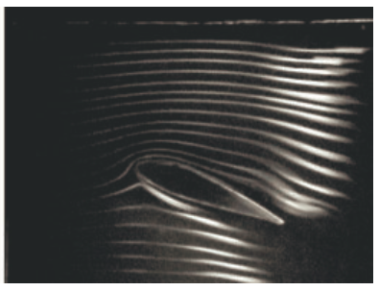
Cambridge Professor Holger Babinsky’s smoke experiment
This shows that air on the top surface does travel faster.
But the real question is WHY?
Notes:
A law known as the Bernoulli equation means that when pressure is lower, air moves faster – so the air stream above the wing does move more quickly than the one below, but this is not what causes the difference in pressure.
According to conventional wisdom the pressure change happens because the air on the curved upper surface of the wing has further to travel than that below the flat underneath surface, meaning it must travel faster to arrive at the other side of the wing at the same time.
In fact the real explanation is nothing to do with the distance the air has to travel. The curvature of the wing causes the change in air pressure because it pulls some of the air upwards, which reduces pressure, and forces the rest beneath it, creating higher pressure.
*****"There is no law in physics which states when streams of particles start at the leading edge of the wing they should reach the tailing edge at the same time.
http://www.telegraph.co.uk/science/science-news/9035708/Cambridge-scientist-debunks-flying-myth.html
This shows that air on top surface does travel faster—but not because it has to reach the trailing edge of the airfoil at the same time!

Slide 15
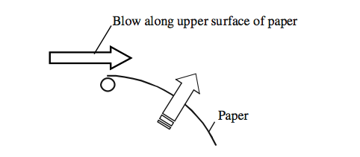
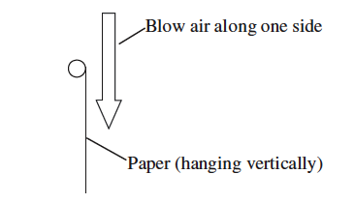
Demonstration: Blow across a curved surface (paper) and this will lift the paper.
But…
if we blow on a straight surface, the paper is not deflected to the side.
SO IT HAS TO BE A CURVED SURFACE!
Notes:
This is where speaker can do the demo of blowing over top of paper;
The curved surface is reponsibible for the pressure difference, not the faster moving air.
So air moves faster BECAUSE of the pressure difference, not the reverse (that pressure difference is caused by the faster moving air)
Newtons’s 2nd law is at work here—that a force causes acceleration

Slide 16
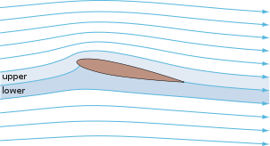
The curvature of the wing causes the change in air pressure because it pulls some of the air upwards, which reduces pressure, and forces the rest beneath it, creating higher pressure.
http://en.wikipedia.org/wiki/Airfoil

Slide 17
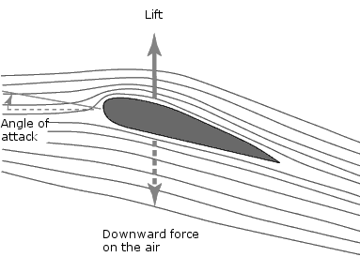
But Physicists also look to Newton’s Third Law:
All forces in the universe occur in equal but oppositely directed pairs.
http://labman.phys.utk.edu/phys221/modules/m9/turbulence.htm
Air is deflected downward; therefore the opposing force is “lift.”
Notes:
Try sticking your hand outside a car window as you travel—the deflection of the air downward results in your hand being “pushed” upward.

Slide 18
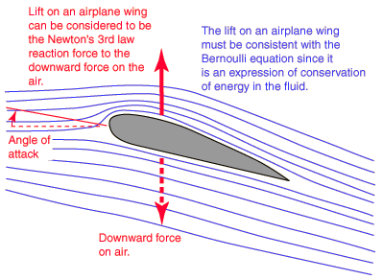
So which is correct? Probably both.
http://hyperphysics.phy-astr.gsu.edu/hbase/fluids/angatt.html
Notes:
That’s the cool thing about science—there’s always new knowledge that can be generated to support or debunk a theory!

Slide 19
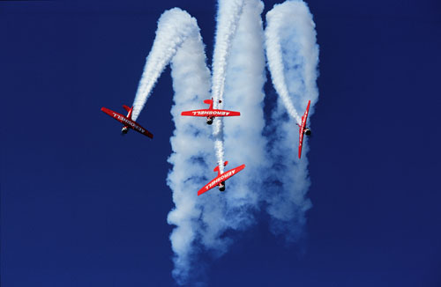
Aircraft Design: Wing shapes

Slide 20
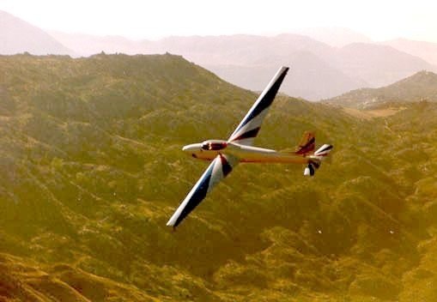
Ever wonder why some wings look like this?
http://www.visitusa.com/planes/232.jpg

Slide 21
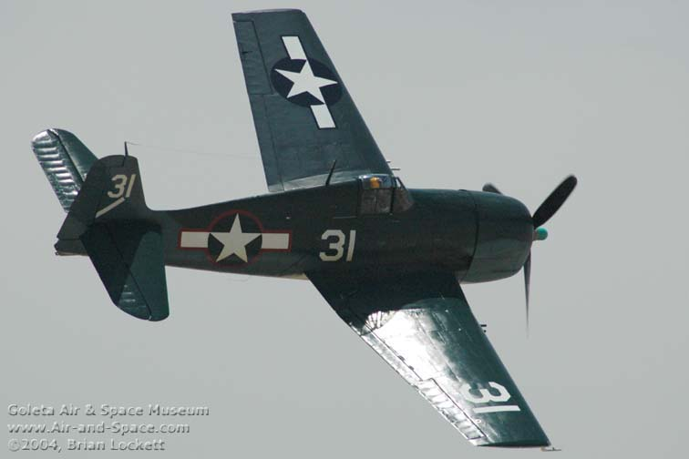
And others look like this?
www.air-and-space.com

Slide 22
Aspect ratio
AE = Span / Ave. chord
AR = 4
AR = 8
These two wings have same area.

Slide 23
Aspect Ratio
Very high aspect ratio: lower stall speed
  Less drag
  Greatest lift
  Lower maximum speed
Aircraft 1 2 3 4
Wing span 40’ 35’ 48’ 30’
Average Wing 6’ 5’ 6’ 6’
Chord
Which aircraft has highest aspect ratio?

Slide 24
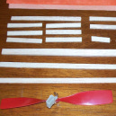
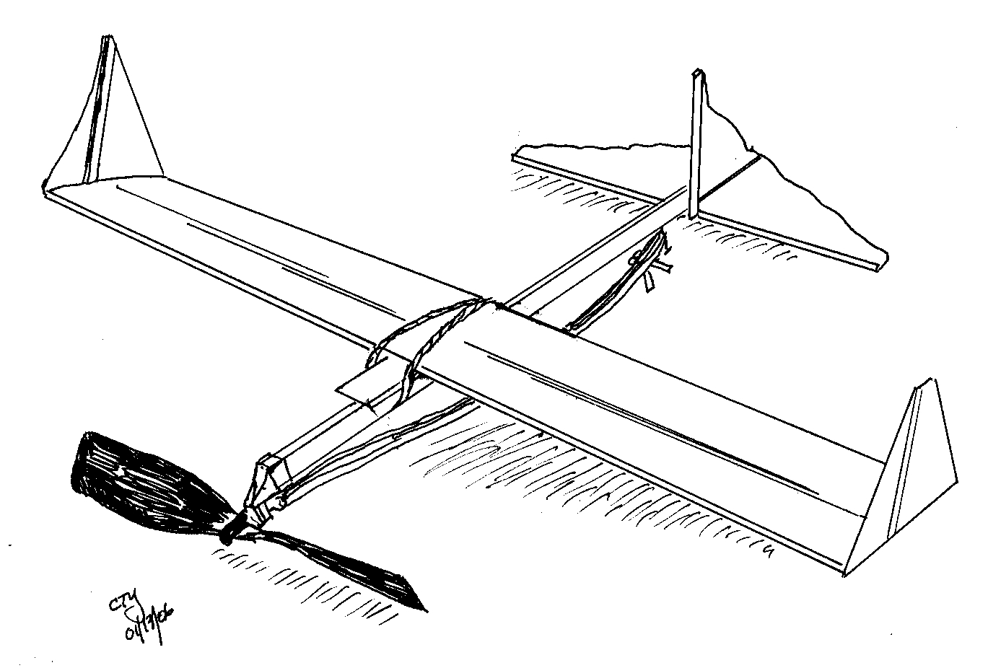
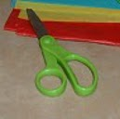
Make your own balsa plane that flies!
http://www.rubber-power.com/make-it.htm
Rubberpower.com

Slide 25
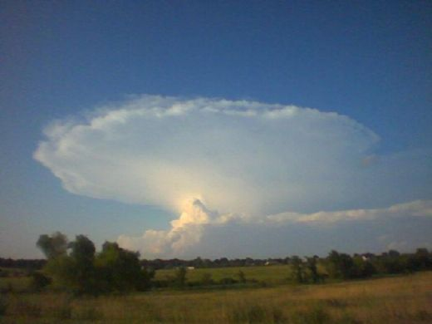
WEATHER
CAPT. TERESE BARTA

Slide 26

THE HEATING OF THE EARTH
The major source of all weather is the sun.
Notes:
1) Air is heated unevenly by solar radiation.
2) Heated air rises and moves. Cooler air sinks.

Slide 27

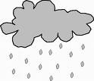

THE HEATING OF THE EARTH
Every physical process of weather is accompanied by or a result of unequal heating of the earth’s surface
Notes:
Uneven heating causes changes in TEMP.
Warm air takes on more moisture, which can cool, condense and become PRECIP
As air is pulled into to rising columns, and as it descends, it creates WIND
Pilots are primarily concerned with wind (direction and speed), visibility and cloud layers—both are moisture related, and air pressure (because it affects the performance of the engine and the lift of the wings.
We also want to know the chances for storms, a hazardous condition for flying.
In winter, icing is also a concern.

Slide 28
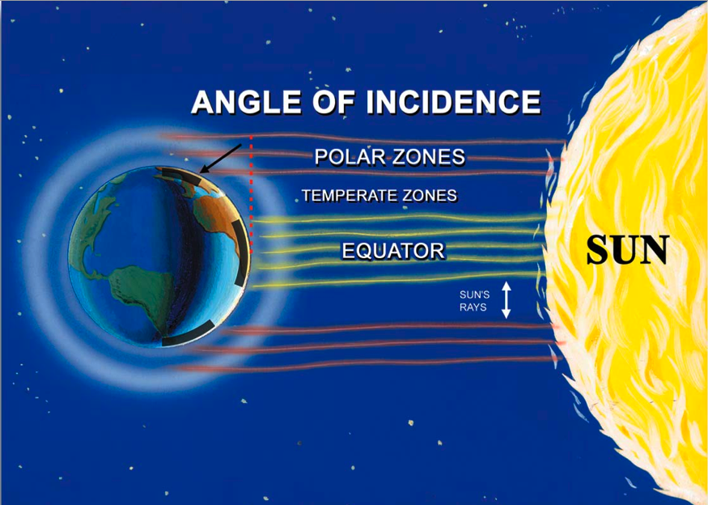
Insolation is greatest at equator
Changes or variation of weather patterns
are caused by the unequal heating of the earth’s surface.
Notes:
On global scale, we understand the uneven heating principle. Insolence is the angle at which the sun’s rays hit the earth. The equator gets the radiation more directly—this part of the earth is therefore warmer. Also, wetter, because the warm air pulls in more moisture from the oceans, and as it rises and cools, results in rain.
This happens on a smaller scale as well throughout the earth.

Slide 29
Warm, light air rises
cool, dense air sinks
Cool, dense air moving inland from over the water.
Notes:
An example of how rising and falling air creates wind—A sea breeze is cooler air moving inland from over the water.
At night, it reverses direction because the land cools more quickly than the water.

Slide 30
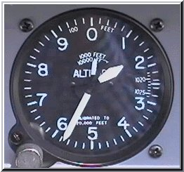
Air Pressure
Air has weight: about 15 lb/sq.in
  The higher we fly, the less dense the air is
  Decreases 1” Hg per 1000 feet
Notes:
Basis for measuring altitude—altimeter
But air pressure changes daily, so it needs to be adjusted every time we fly, and as we fly (weather reports state pressure)

Slide 31
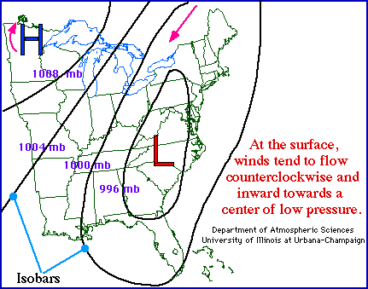
High vs. Low Pressure
Areas of rising air are called low pressure centers (less dense air)
Areas of sinking air are high pressure centers (denser air)
High and Low pressure regions designated on weather map

Slide 32
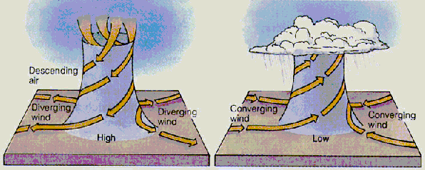
Highs and lows
High pressure at surface
Air flow down, out and clockwise
Low pressure at surface air flow
Up, in, and counter clockwise
Air rises cools and often forms
Clouds and precipitation
Nasa Link
Nasa Link
Notes:
High pressure usually associated w/ good weather for flying
Low pressure means bad weather because of precipitation, clouds.
NASA Visible earth links:
http://visibleearth.nasa.gov/view.php?id=54425
http://visibleearth.nasa.gov/view.php?id=54422
Also see: http://www.usatoday.com/weather/tg/whighlow/whighlow.htm

Slide 33
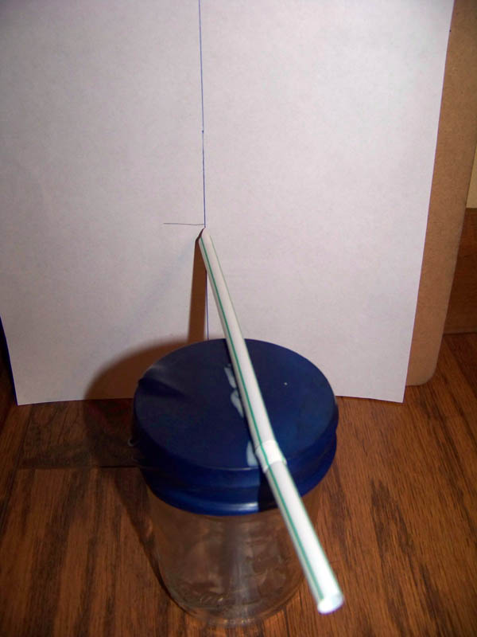
Changes in Air pressure signal weather changes
Make a barometer:
Cut off stem of balloon
Stretch top part over jar
Attach small paper point to straw
Glue straw to top of balloon
Measure on paper where straw tip is every 12-24 hrs
Compare to daily pressure
(check weather websites)
Notes:
CHANGES IN AIR PRESSURE—we use air pressure to calibrate our flight instruments for determining altitude.
Neat Youtube video on making home made barometer (except I think they have the direction of the straw reversed for low vs. high pressure—higher pressure should press down on balloon and straw should go down. The reverse happens for low pressure—the air in the jar expands and the straw should rise up.
Youtube (how to make a barometer):
http://www.youtube.com/watch?v=jmQ8FWnM0fA&feature=related

Slide 34
AIR MASSES AND FRONTS
The boundary between air masses of different densities is called a FRONT.

Slide 35

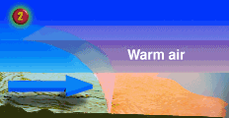
Cold front
(2) Cold front plows into warmer
lighter air forming towering
clouds rain and thunderstorms
(1) Leading edge of an
Advancing cold air mass
Notes:
A cold front is the leading edge of an advancing cold air mass. Cold fronts can be fast or slow.
Fast moving Cold fronts tend to cause storms

Slide 36

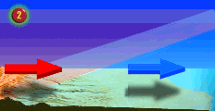
Warm front
Cold air is still the boss
Heaver denser cold air retreats slowly as warm air rides up and over cold and spawns
Widespread clouds & precipitation
Notes:
A warm front is the leading edge of an advancing warm air mass. Warm fronts move about half as fast as cold fronts.

Slide 37

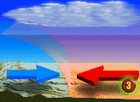

Stationary front
(1) cool dry
Air mass
(2) butts up against an
equally strong mass
of Warm humid air
(3) battles for control
Ends with no winners
Front moves little
Notes:
A stationary front occurs when warm and cold fronts meet but neither moves.

Slide 38
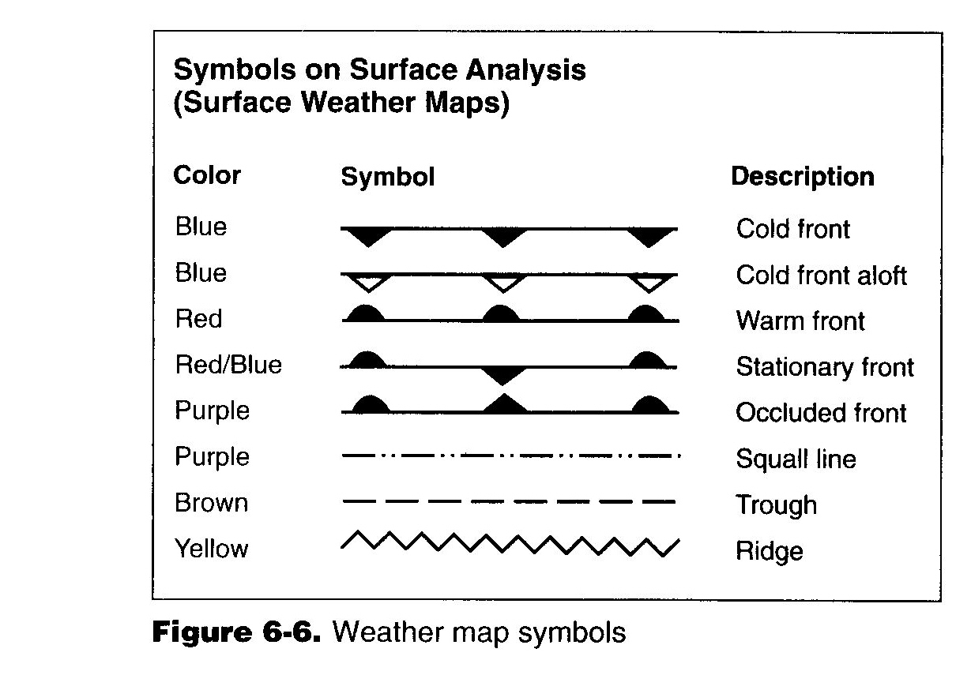
Symbols that appear on weather maps:

Slide 39
MOISTURE
Air has moisture (water vapor) in it. The water vapor content of air can be expressed in two different ways.
The two commonly used terms are
relative humidity and dew point.

Slide 40
Relative humidity
Relative humidity relates the actual water vapor present in the air to that which could be present in the air.
Air with 100% relative humidity is said to be saturated, and less than 100% is unsaturated.

Slide 41
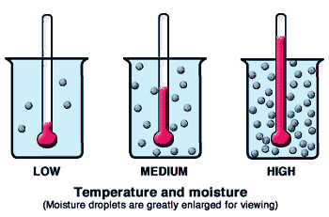
MOISTURE
Temperature largely determines the maximum amount of water vapor air can hold.
  Warm air can hold more water vapor than can cold air
http://virtualskies.arc.nasa.gov/weather/4.html

Slide 42
DEW POINT
Dew point is the temperature to which air must be cooled to become saturated by water already present in the air.

Slide 43
Dewpoint depends on temperature
Cold Air
reaches its
point of
saturation
sooner.
A cloud forms when the air reaches its point of saturation
Warm Air
Holds more
water
More space between
air molecules means
more room for
water molecules
Unlike
air molecules,
water molecules
like to cling to
one another.

Slide 44
MOISTURE
When water vapor condenses on large objects such as leaves, windshields, or airplanes, it will form dew.
When it condenses on microscopic particles such as salt, dust or combustion by-products ( condensation nuclei), it will form clouds or fog.

Slide 45
MOISTURE
If the temperature and dew point spread is small and decreasing, condensation is about to occur.
If the temperature is above freezing, the weather most likely to develop will be fog or low clouds.

Slide 46
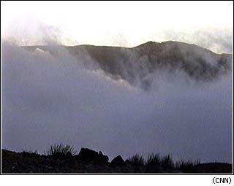
FOG
Fog is a surface-based cloud (restricting visibility) composed of either water droplets or ice crystals.
Fog may form by cooling the air to its dew point or by adding moisture to the air near the ground.

Slide 47

Radiation fog (ground fog) is formed when terrestrial radiation cools the ground, which in turn cools the air in contact with it. When the air is cooled to its dew point ( or within a few degrees), fog will form.
This fog will form most readily in warm, moist air over low, flatland areas on clear, calm (no wind ) nights.

Slide 48
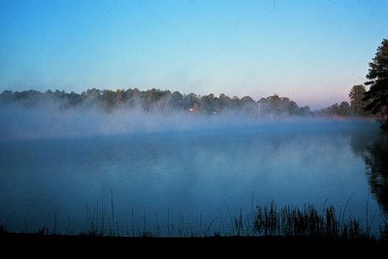
FOG
Steam fog forms in the winter when cold, dry air passes from land areas over comparatively warm ocean waters. Low-level turbulence can occur and icing can become hazardous in a steam fog.

Slide 49
Clouds

Slide 50
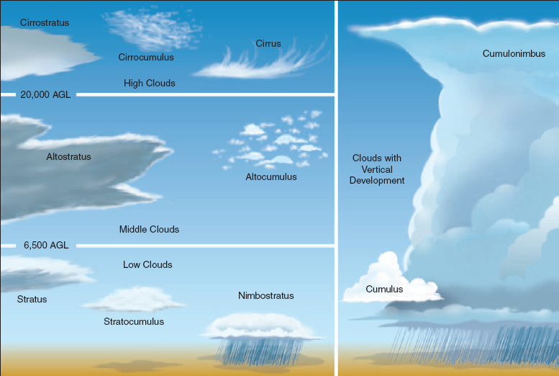
Notes:
Clouds classified into 4 types (High/middle/low/ and those with vertical development)
High clouds, called cirrus, are composed mainly of ice crystals: therefore they are least likely to contribute to structural icing (since it requires water droplets).
Stratiform clouds are the flat, more evenly based clouds formed in stable conditions. They produce steady, continuous light rain and drizzle made up of much smaller raindrops.
Cumuliform clouds are the billowy-type clouds having considerable vertical development*, which enhances the growth rate of precipitation.
Nimbo- or –nimbus mean rain cloud

Slide 51
CLOUDS
The base of a cloud (AGL) that is formed by vertical currents (cumuliform clouds) can be estimated by:
(surface temperature minus dew point) x 1,000
4.4
(The convergence of the temperature and the dew point lapse rate is 4.4⁰F per 1,000 ft)

Slide 52
Problem: what is the approximate base of the cumulus if the surface air temperature is 70°F and the dew point is 61°F?
Solution:
Use the following steps: 2. 9/4.4 = 2.05 or 2
1. 70° F (temperature ) 2x 1,000 =2.000 ft
- 61° F (dew point ) (base of cloud, AGL)
9⁰F

Slide 53
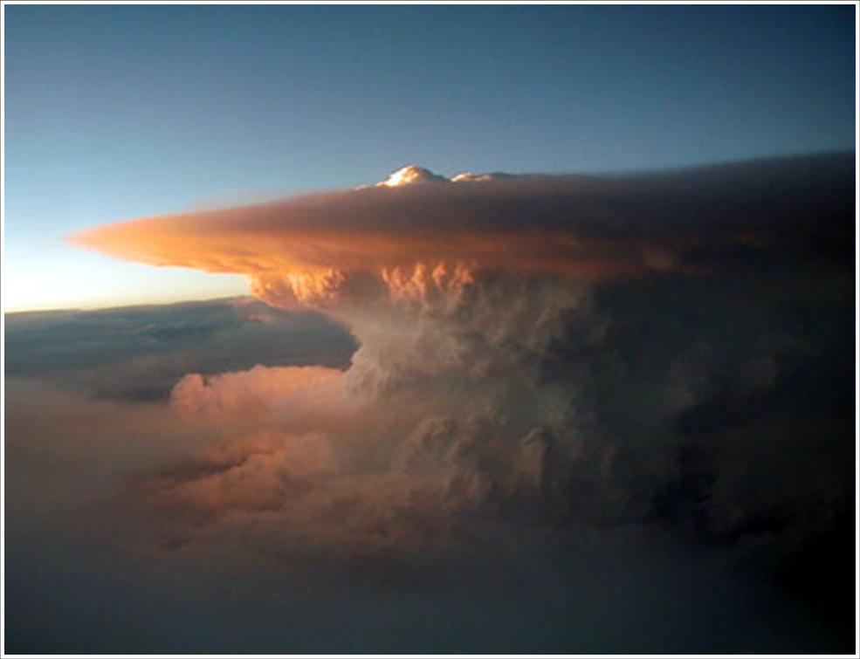
THUNDERSTORMS
Thunderstorms present many hazards to flying.
http://www.purdue.edu/eas/mct/supercell_tornadic_thunderstorms/Supercell%20Tstorm.jpg
Notes:
What do you think is the most rugged airplane? The fighter!
There is a fighter squadron with the following on a sign above the briefing room: There is no reason to fly into a thunderstorm in peace time.

Slide 54
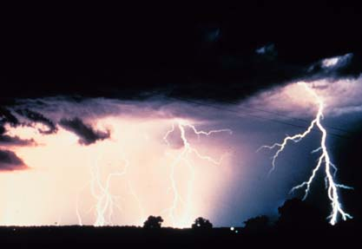
THUNDERSTORMS
Three conditions necessary to the
formation of a thunderstorm are:
1. Sufficient water vapor
2. Unstable air (wants to rise)
3. An initial upward boost (lifting)*
* can be caused by heating from below, frontal lifting, or by mechanical lifting ( wind blowing air upslope on a mountain)
http://www.ngdc.noaa.gov/

Slide 55
Notes:
A fast moving cold front can cause set off a T-storm, as it creates the “push” or lifting force to an unstable mass of air

Slide 56
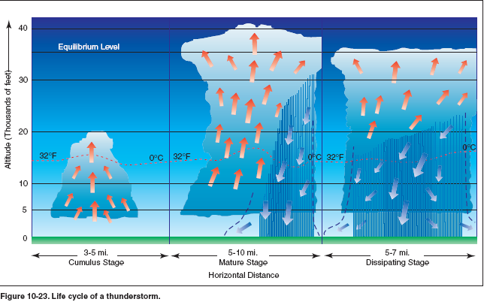
THUNDERSTORMS
There are three stages of a thunderstorm:
The building stage
Mature stage
Rain begins to fall
Mostly all downdrafts
Notes:
!) The Cumulus (building) stage is characterized by continuous updrafts, and these updrafts create low-pressure areas.
2) Mature stage: thunderstorms reach their greatest intensity during this stage which is characterized by updrafts and downdrafts inside the cloud.
Precipitation inside the cloud aids in the development of these down drafts, and the start of rain from the base of the cloud signals the beginning of the mature stage.
3) Dissipating stage: characterized predominantly by downdrafts. They can be very dangerous

Slide 57
Avoid operating anywhere near a thunderstorm (within 20 NM).
Notes:
Pilots need to avoid T-storms by at least 20 nautical miles

Slide 58

How high did I fly?
Model Rockets-Finding Apogee
Major Roger R. Rognrud CAP
Notes:
58

Slide 59
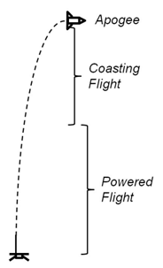
Apogee is the Highest Altitude that a Rocket will reach in it’s Flight path.
Notes:
59

Slide 60
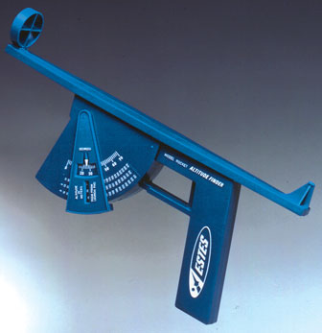
Measuring your Rocket’s Apogee.
Model Rocket apogee can be measured with optical tracking! This is the easiest method. But what if you don’t have the $20 dollars or more to buy one of these? Use Trigonometry and make one yourself !

Slide 61
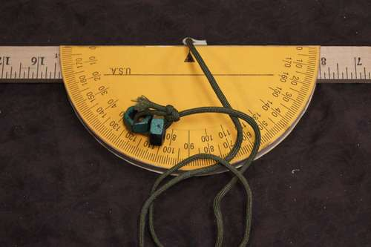
You need some way to collect your numbers! You can build an elevation tracker out of a protractor and a yard stick.-
You are building a tool for the ELEVATION-ANGLE TRACKING calculation method for Apogee!
When aimed at your model rocket the weighted string line will show you the angle in degrees that the rocket reaches at apogee or the rocket’s highest point. Write this number down you will need it for your calculation.

Slide 62
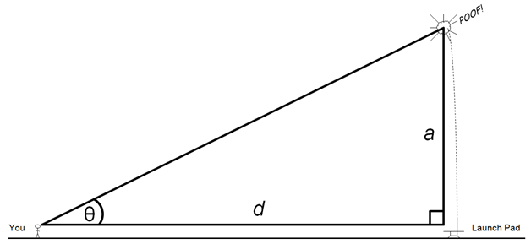
At your rocket launch site you need to create a right triangle.
On the right side of this right triangle is your model rocket Launch Pad. Side a.

Slide 63
How does all the Trigonometry work-
While we can think of rocket flight as a straight line- The right triangle calculation for your rocket is actually thought of as being a part of a circle.
As part of a circle we get to apply TANGENTS to the angles measure in degrees.
The tangent of an angle (theta) θ in a right triangle is as the ratio of the side lengths opposite to the angle and adjacent the angle. Cool stuff !

Slide 64

You are, let say, on the left side of an imaginary right triangle that you have created at your launch site.
The distance from your launch pad and you should be at least 300 feet. You should measure this distance carefully.
At this distance you will be far enough away to be able to see your rocket’s flight path clearly.
At this angle your calculations may be more accurate with the elevation-angle method.

Slide 65

When your rocket is launched aim your incline device at your rocket and when it reaches it’s highest point of flight make note of the degree angle that is indicted by the string on your protractor.

Slide 66
This is where Trigonometry comes in-
(Tangent of angle) X( Distance from Launch Pad)= Rocket Altitude
Tan of Angle of a X d = a or Altitude

Slide 67

This is not hard if you have -
A Table of Angles and their Tangents!
Refer to Angle
A

Slide 68
Lets collect the data! (Example)
You have launched your rocket and aimed your inclinometer and have an angle of 80 degrees at apogee, Angle a.
You are a measured distance from your launch pad of 300 feet, or d.

Slide 69
Lets do the calculation!
. Tan of Angle of a X d = a or Altitude
Tan a is 80 degrees and equal to 5.648 X
d is equal to 300 feet =1694.4 ft.
WOW ! That’s a great Flight! Looks Easy now.

Slide 70
Limitations
This method is also limited by the angle of deviation from a straight vertical flight that the rocket might take in flight due to wind and flight characteristics of the rocket itself. Oh Well-
The Elevation Angle method is not very accurate but will give you a good estimate of the highest altitude/incline at Apogee that your rocket reached.
This method should not be considered as accurate as altitude obtained from an altimeter or radar it is closer to the highest incline at apogee.

Slide 71


What is important here!
Have Fun !!! Thank You.

Slide 72
Teaching Newton’s Laws of Motion
Utilizing a Hands-On Demonstration of the
Laws via a Vacuum Cleaner Launcher

Slide 73
Teaching Newton’s Laws of Motion
Every object in a state of uniform motion tends to remain in that state of motion unless an external force is applied to it. (This is basically Galileo’s concept of “inertia”, and is often referred to as the “Law of Inertia”.)
The acceleration (a) of an object is proportional to the force (F) applied and inversely proportional to the mass (m) of the object: F = ma. (Mass is not the same as weight, but for our discussion we can use weight instead of mass if it confuses your student.)
For every action there is an equal and opposite reaction.

Slide 74
Teaching Newton’s Laws of Motion
Law 1: Every object in a state of uniform motion tends to remain in that state of motion unless an external force is applied to it.
  A stationary object will remain that way, unless acted upon by an outside force.
  An object in motion will remain in motion in a straight line and at a constant velocity, unless acted upon by an outside force.

Slide 75
Teaching Newton’s Laws of Motion
Law 2: The acceleration (a) of an object is proportional to the force (F) applied and inversely proportional to the mass (m) of the object: F = ma.
  The acceleration (or deceleration) is the amount of force applied relative to the mass of the object.
  The change in velocity (speed) is the amount of force applied over time.

Slide 76
Teaching Newton’s Laws of Motion
Demonstrating the first two laws of motion - indoors
  Roll a ball back and forth on the floor
  Kick a ball softly
  Kick it hard!

Slide 77
Teaching Newton’s Laws of Motion
Demonstrating the first two laws of motion - outdoors
  Parts List
  1 roll of ¾ inch masking tape
  1 roll of 1½ inch masking tape
  1 3 x 5 card
  1 schedule 40 tee, 1¼x1¼x1” (ask the folks in plumbing)
  2 schedule 40 pipes, 1¼” diameter 5 feet long
  1 vacuum cleaner with a hose or a Shop-Vac
  Play-Doh

Slide 78

Teaching Newton’s Laws of Motion

Slide 79

Teaching Newton’s Laws of Motion

Slide 80

Teaching Newton’s Laws of Motion

Slide 81

Teaching Newton’s Laws of Motion

Slide 82
Teaching Newton’s Laws of Motion
Follow-Up Questions
Which pipe produced the longest flight? Why?
Which pipe took the longest time for the ball to move from one end to the other?
Does the amount and velocity of suction from the vacuum cleaner have any effect on the flight of the ball? Why?
Why does the ball slow down and fall to the ground?

Slide 83
Resources
http://www.instructables.com/id/Make-a-Vacuum-cleaner-Bazooka/
http://www.instructables.com
An interesting resource for fun things to do, some of which demonstrate scientific principles.
Vacuum Bazookas, Electric Rainbow Jelly, and 27 Other Saturday Science Projects. Neil A Downie ISBN: 9780691009865
Civil Air Patrol, Aerospace Education Member Resources
http://www.capmembers.com/aerospace_education/
Resources for over 20 hands-on science lessons, as well as resources for model rocketry, robotics, satellite test kit software to experiment with orbits in space, software for designing and building model airplanes, and much more!
Visit http://www.gocivilairpatrol.com/cap_home/educators/ for more information.

Slide 84
Thank you for allowing us to present to your conference.
Any questions before the demonstration?

